Slide 1
PyGWalker - a visual guide to navigate Styles with Python

Slide 2

Content
Introduction
Installation
How Pygwalker work?
Conclusion

Slide 3

A more efficient method to improve our data analysis and visualization in Jupyter Notebook using PyGWalker. This library converts our pandas and polars DataFrames into a user-friendly Tableau-style interface, making visual exploration easier.
Introduction

Slide 4
Installation
Before you use pygwalker, please make sure that we have installed the necessary packages via the command line using pip or conda.
install the required packages through the command line using pip or conda before using pygwalker.
-!pip install -q --pre pygwalker

Slide 5
How does Pygwalker work?
Import PyGWalker and Pandas in Jupyter Notebook
Pass the pygwalker to the DataFrames
The Dataframe is divided into columns on the left, with a separation between numerical and non-numerical values.
After executing the cell, a visually appealing interface will display the variables present in the dataset, categorized according to their types.
Charts for Correlation, filter
Suppose we wish to analyze the sales data for a particular store throughout the year. Pygwalker offers a feature called filters for this purpose. By dragging and dropping fields into the Filter box, we can easily configure them.

Slide 6
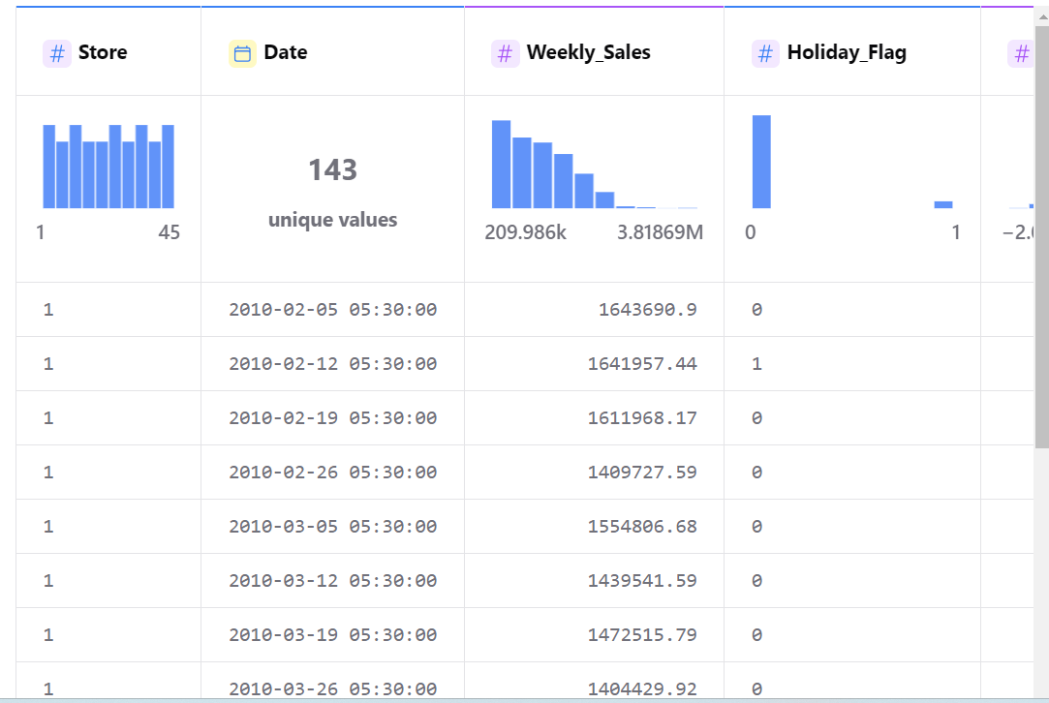
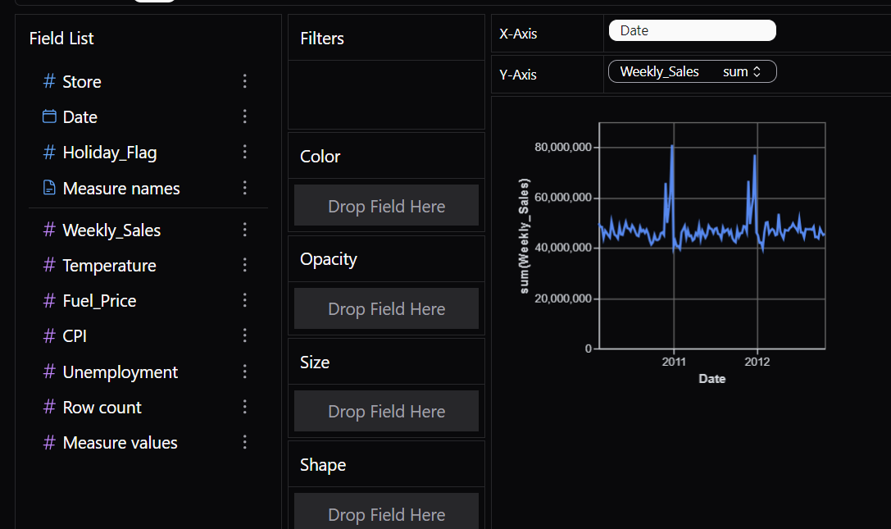
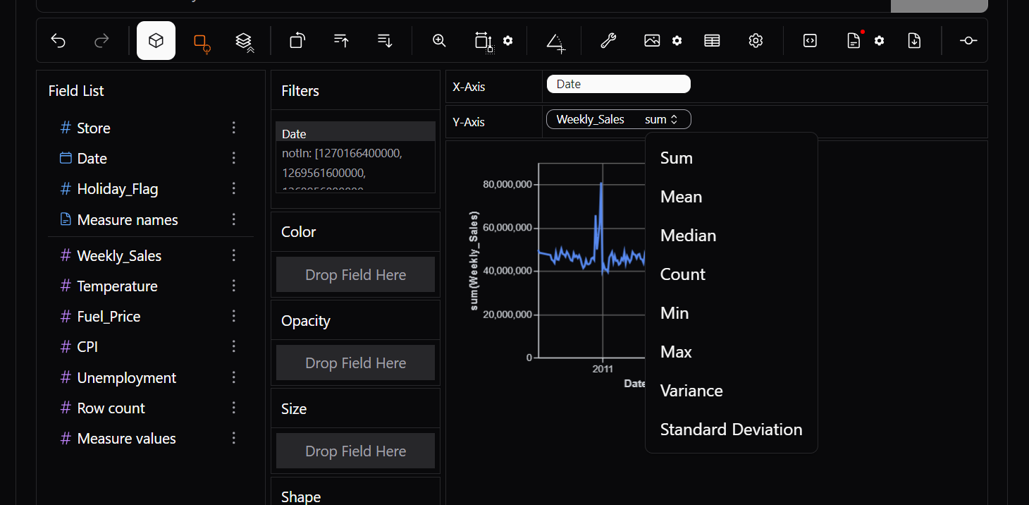
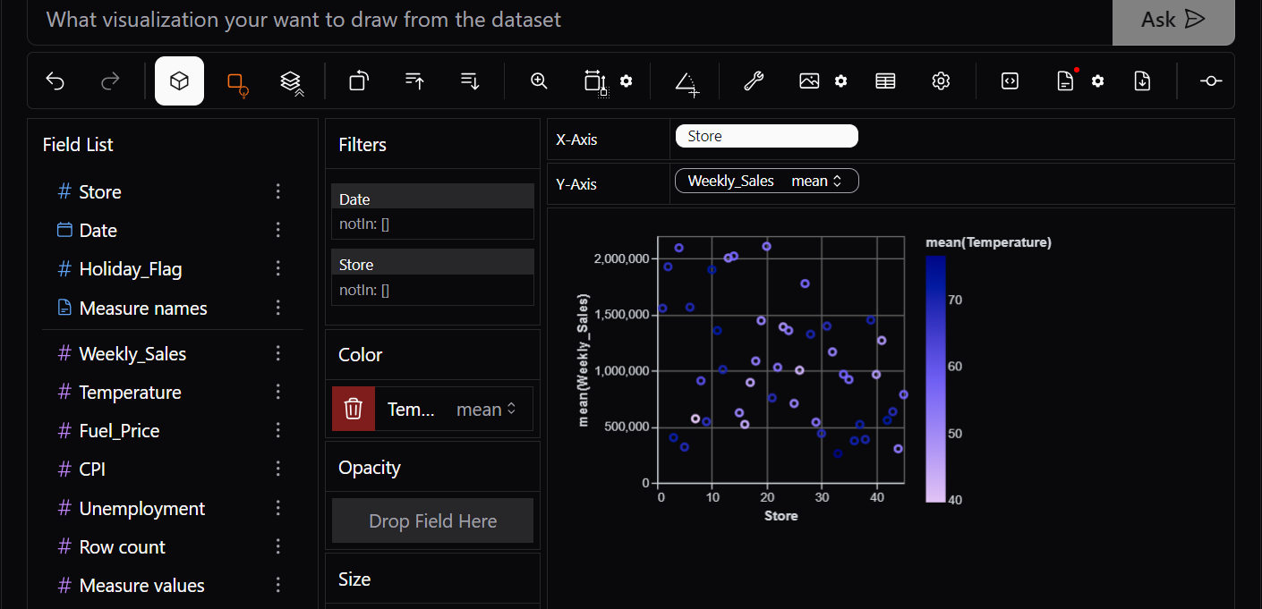
Data View
Datewise Sales
Aggregation
Storewise Sales

Slide 7
Conclusion
PyGWalker offers a wide range of features. For instance, users can visualize aggregated data using different functions such as median, mean, standard deviation, count, sum, and more. Additionally, users can select from various plot styles, bin and log scale data, export images in PNG or SVG format, stack charts, and access numerous other functionalities.
GitHub: https://github.com/ds-stratgic-work/PygWalker-Visualization-with-python.git

Slide 8


Thank You
dSights is a data tech specialist with a vision to create value through:
Outcome-Oriented AI
Fueled by
Innovative Experimentation

